Slide 1

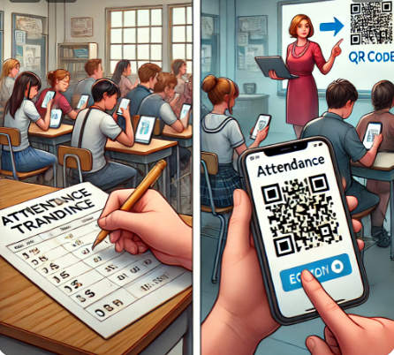
Attendence Tracking using QR system
A Software Solution for Automated Attendance Management
Authors: Layan Khalil , Raheeq Daraghmeh , yaqeen rami
Instructor:prof.amjad rattrout

Slide 2
Abstract
Attendance tracking is crucial for institutions but prone to human error and inefficiency. This project implements a QR Code-based attendance system to automate the process, ensuring accuracy and ease of use. Students simply scan the QR codes through a user-friendly interface. The system saves time, enhances data authenticity, organizes attendance records in a centralized database, and provides an intuitive experience for both students and teachers.

Slide 3
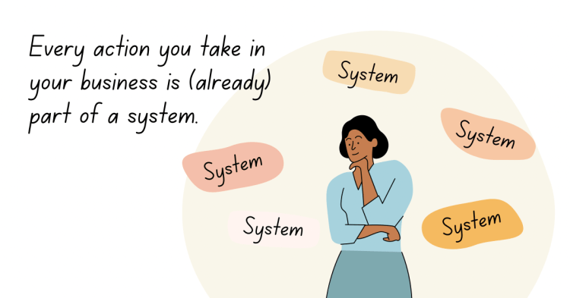
🔹 Why did we develop this system?
Problem Statement: Manual attendance tracking is prone to errors, time-consuming, and inefficient.
Solution: Using QR code technology to automate attendance tracking efficiently.
Goal: Improve accuracy, reduce time wastage, and enhance attendance management.

Slide 4
🔹 Project Objectives
📌 What do we aim to achieve?
Automate the attendance tracking process
Minimize human errors and fraud
Provide real-time attendance records
Generate attendance reports
Ensure data security and privacy

Slide 5
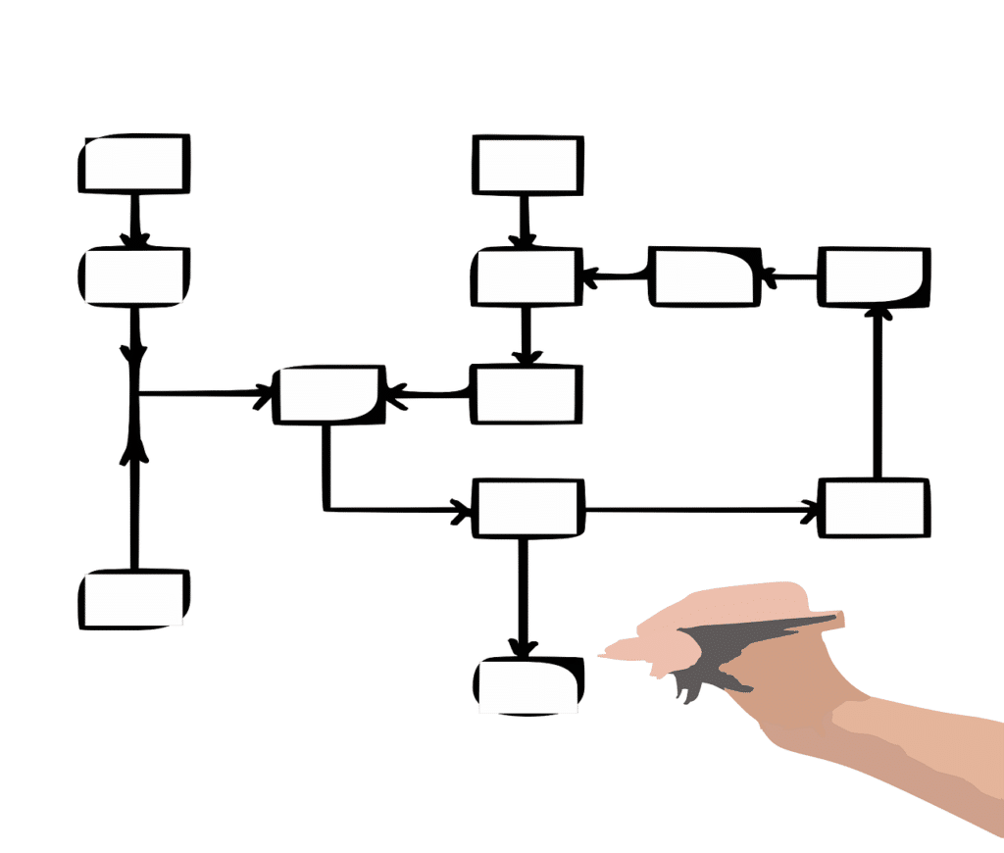
System Workflow
01

Slide 6
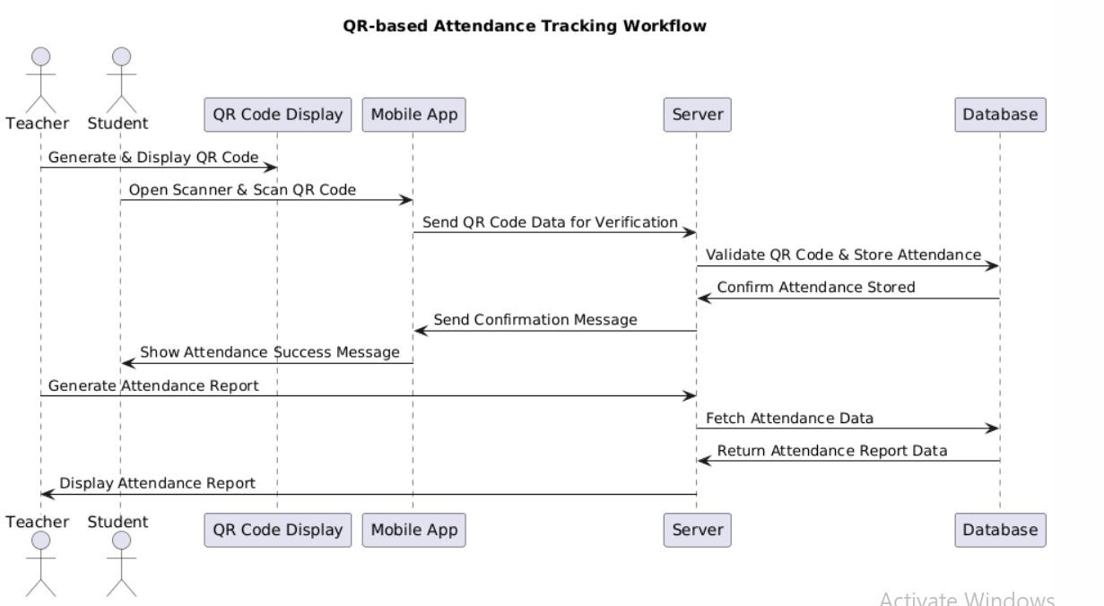
How Does The System Work?

Slide 7
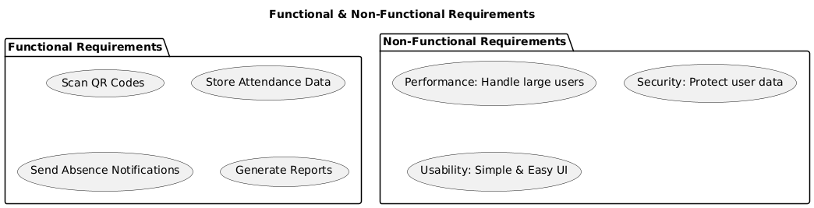
Functional & Non-functional Requirements

Slide 8
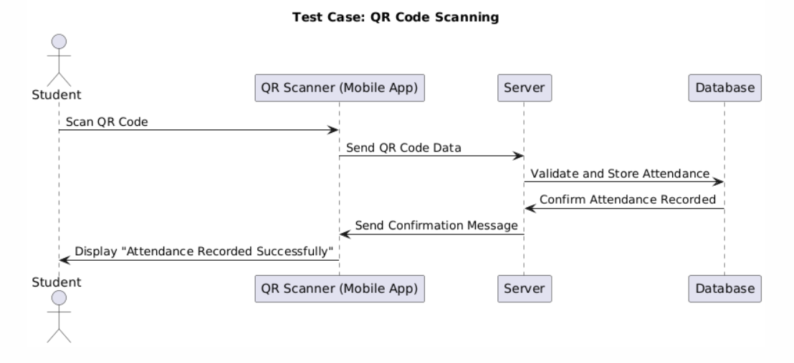
Requirements Validation
Requirement validation ensures that the requirements are correct, complete, and feasible.
Example Requirement Validation Scenarios:
**Test Case for QR Code Scanning
Scenario: A student scans their QR code within class time.
Expected Outcome: The system registers attendance and updates the database.
Test Result: ✅ Passed (Attendance recorded successfully)

Slide 9
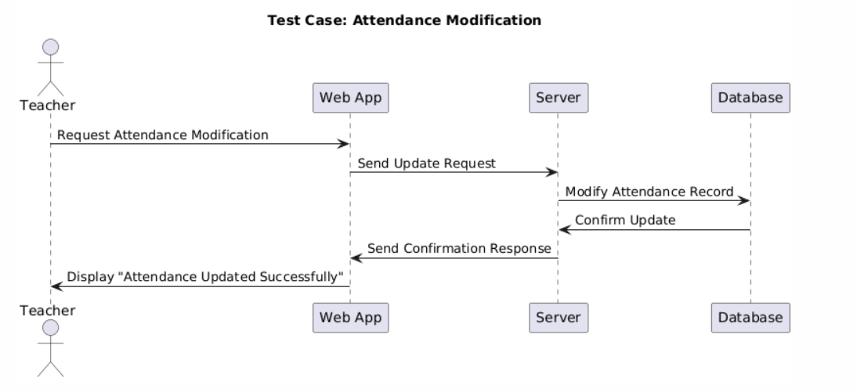
Requirements Validation
**Test Case for Attendance Modification
Scenario: A teacher edits a student’s attendance due to an excused absence.
Expected Outcome: The attendance log updates correctly, and the student gets a confirmation.
Test Result: ✅ Passed (Modification reflected in the system)

Slide 10
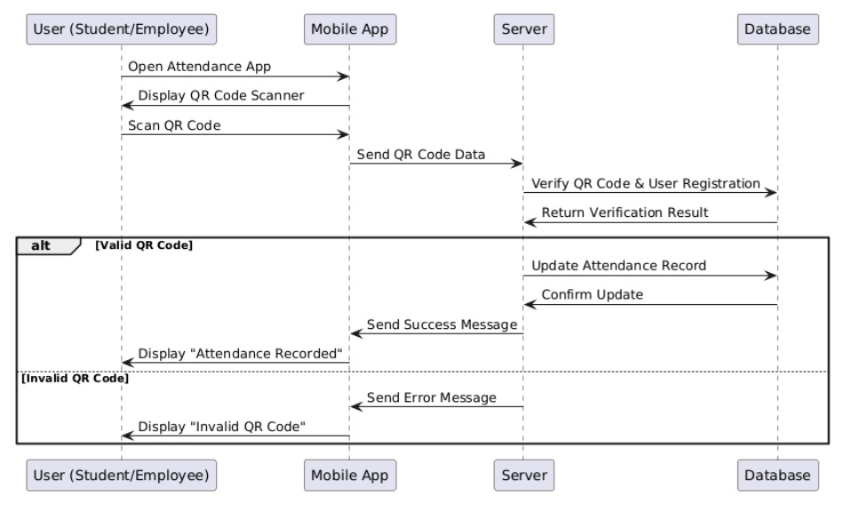
Sequence Diagram
01
02
03
04

Slide 11


Methodology Used
We followed the Agile methodology to ensure flexibility, continuous improvement, and stakeholder collaboration throughout the development of the QR-based attendance system. Below is how we implemented Agile principles in our project.
SCRUM
XP Programming

Slide 12
How can Agile framework be integrated in our project ?
1.dentify Agile Framework:
Scrum: Used if structured sprints and defined roles are needed.
Kanban: Used for continuous workflow and task visualization
2.Set Up Agile Workflow
Define Roles:
Product Owner: Manages backlog and priorities.
Scrum Master: Ensures Agile practices are followed.
Development Team: Codes, tests, and delivers features.
Break Down the Project into User Stories:
"As a teacher, I want to generate QR codes for attendance."
"As a student, I want to scan QR codes to record attendance."
"As an admin, I want to access attendance reports."
3.Implement Agile Iterations
Sprint Planning:
Sprint 1: Develop QR Code generation & scanning.
Sprint 2: Integrate database & store attendance data.
Sprint 3: Build attendance reports & admin dashboard.
Sprint 4: Improve UI and add security features.
Daily Stand-ups: Track team progress and remove blockers.
Notes:
Kanban is a popular framework used to implement Agile software development. It requires real-time communication of capacity and full transparency of work. Work items are represented visually on a kanban board, allowing team members to see the state of every piece of work at any time.

Slide 13
How can Agile framework be integrated in our project ?
4.Continuous Testing & Validation
Test-Driven Development (TDD): Write tests before implementing features.
User Acceptance Testing (UAT): Gather feedback from teachers and students.
5. Foster Stakeholder Collaboration
Sprint Reviews: Demonstrate features and collect feedback.
Refine Requirements: Adjust project scope based on evolving needs.
6.Adapt to Changes
Modify backlog priorities based on stakeholder feedback.
Add new features (e.g., geolocation or facial recognition).
.
7. Use Agile Tools
Trello/Jira: Manage sprints & backlog.
Slack/MS Teams: Team communication.
GitHub/GitLab: Version control & collaboration.
8.Measure Progress
Velocity: Track how much work is completed per sprint.
Burndown Chart: Monitor progress and remaining tasks.
Notes:
Kanban is a popular framework used to implement Agile software development. It requires real-time communication of capacity and full transparency of work. Work items are represented visually on a kanban board, allowing team members to see the state of every piece of work at any time.

Slide 14
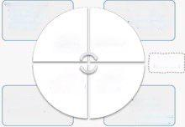
Scrum, an Agile framework, to divide the project into sprints and maintain a flexible approach.
The project was developed in multiple iterations, allowing us to adjust features based on feedback.
We held short meetings to discuss progress and challenges.
Daily standups
Sprints
Sprint Reviews
Sprint Backlog
After each sprint, we reviewed our progress and collected feedback from stakeholders.
Tasks were added to the product backlog and prioritized based on importance.

Slide 15
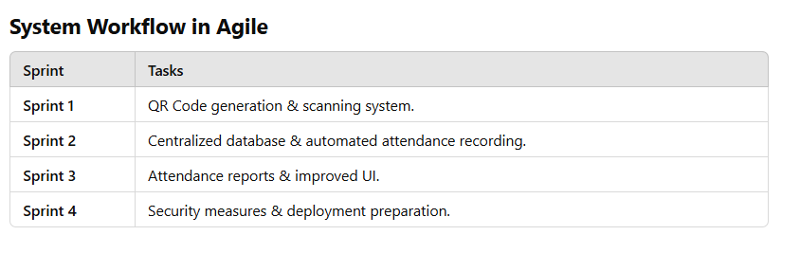
Scrum, an Agile framework, to divide the project into sprints and maintain a flexible approach.
Sprint Reviews

Slide 16
XP (Extreme Programming)
Our QR-based Attendance Tracking System follows Agile principles, with Extreme Programming (XP) as a key development approach. XP focuses on fast iterations, collaboration, continuous testing, and high-quality software delivery. Below, we explain how XP and Agile principles were applied to our project.
Explanation of the XP Process Workflow
✔ Planning → Define User Stories & Iteration Plans. ✔ Design → Keep architecture simple & flexible. ✔ Coding → Apply Pair Programming & Continuous Integration. ✔ Testing → Implement Test-Driven Development (TDD). ✔ Refactoring → Continuously optimize & improve code. ✔ Release → Deploy working system increments. ✔ Iteration → Review progress & start next sprint.

Slide 17
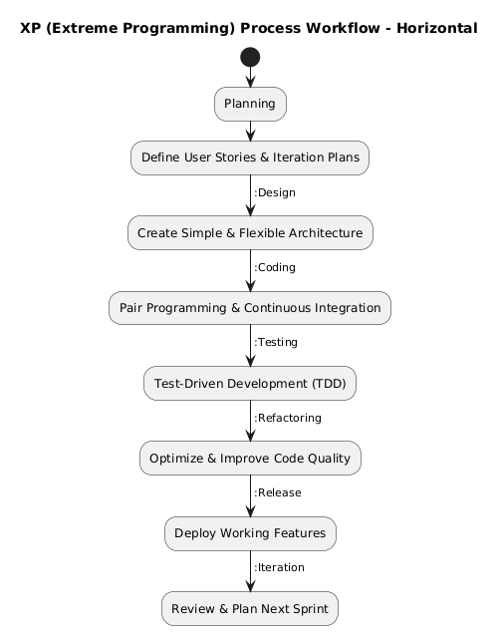
XP in Attendence Tracking

Slide 18
📌 How XP & Agile Improved Our QR-Based Attendance System
✅ Faster development with iterative releases. ✅ Higher software quality due to TDD & continuous testing. ✅ User-focused approach ensuring stakeholder requirements were met. ✅ Seamless collaboration between developers, testers, and users.

Slide 19
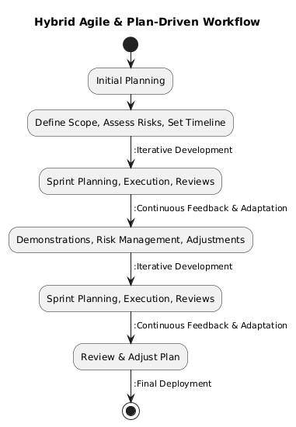
Hybrid Approach (Plan-Driven & Agile) for QR Code Attendance Tracking System
To maximize efficiency, our project combines plan-driven and agile methodologies, ensuring structured planning with flexibility for iterative development and feedback.

Slide 20
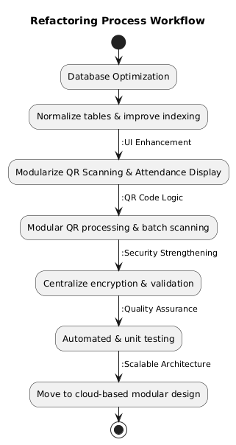
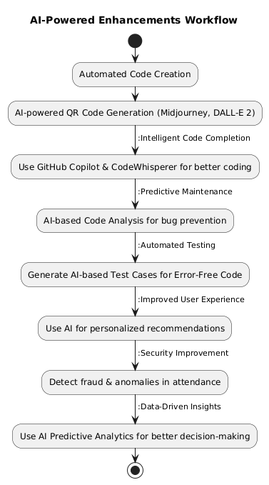
Refactoring & AI in Attendence Tracking

Slide 21
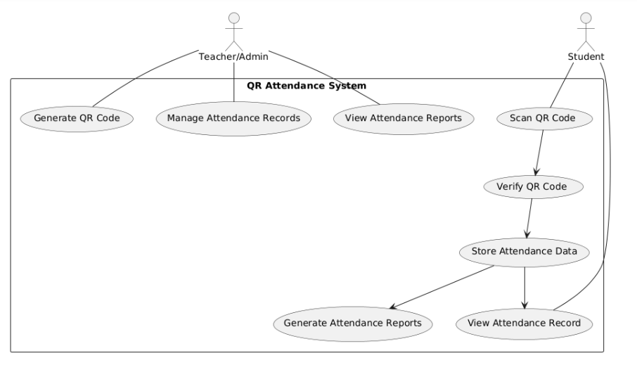
USE-CASE Diagram

Slide 22
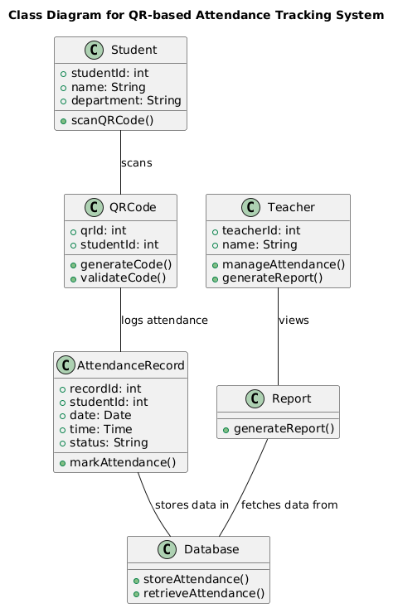
Class Diagram

Slide 23
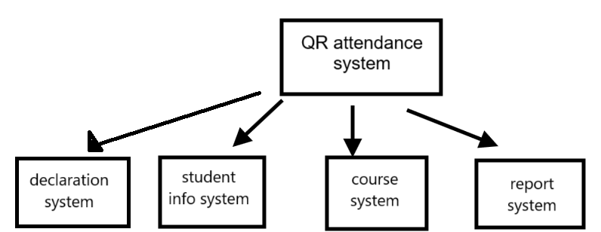
Context Model in QR system
Context Models for the QR Attendance System
Context models help define system boundaries and interactions with external entities.
1.System Scope → The QR Attendance System interacts with teachers & students. 2.Key Functions:
Generate QR Codes → Students scan to register attendance.
Provide Attendance Reports → Teachers can monitor student attendance.
Access Student Information → Retrieve student name & university number.
Link QR Code to Course → Ensure accurate attendance tracking per subject.
3.External Systems Interacting with the QR System:
Student System → Exchanges student data.
Course System → Links course details with QR codes.
Reporting System → Generates reports for teachers.
Student Information System → Sends absence notifications to students.
01
02
03
04

Slide 24
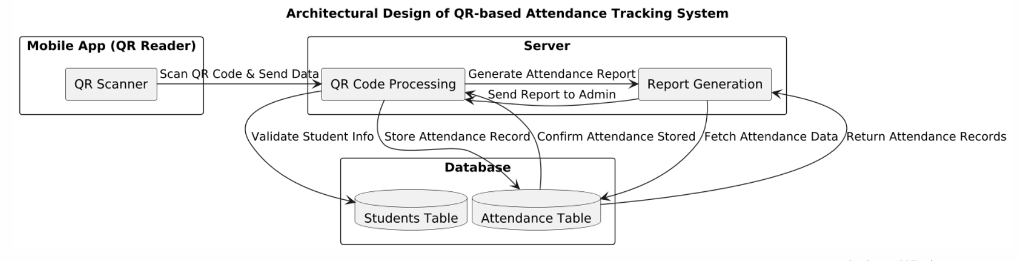
Architectural Design
System Features in Architecture
✔ Performance → Optimized QR code processing minimizes delays in real-time attendance tracking. ✔ Security → Multi-layered encryption & access control protects student data from unauthorized use. ✔ Availability → Ensured through backup database servers & failover mechanisms for system reliability.
01
02
03
04

Slide 25
THANKS!
Do you have any questions?

